Slide 1
Let’s Talk About Privacy --
Before it Disappears
*Thanks AI!
Jen Caltrider
Director, *Privacy Not Included
Mozilla

Slide 2
Why me?
Studied for my Masters Degree in AI back in the day. Learned that I’m terrible at writing code and better at telling stories.
I was CNN’s first technology producer.
Started *Privacy Not Included back in 2017 and have been a consumer privacy researcher since.
I actually really like privacy, and I also really like technology too.
Or -- who are you and why should I listen to what you have to say? All good questions!

Slide 3
Who here cares about privacy?
Raise your hand!
(keep it up for a moment too)

Slide 4
Who here cares about privacy?
Raise your hand!
(keep it up for a moment too)
Who here has read your university’s privacy policies?
(or even knows where to find them?)

Slide 5
There is the problem with privacy
Well…one of the problems at least
There are quite
a few more

Slide 6
Privacy Research -- YAY!
What information is collected?
How much is collected?
How is that information used?
Who has access to that information?
Who is that information shared with and for what purposes?
Do I have any control over my personal information? Can I delete it? Acces it? How long is it retained for?
What is the track record of the company collecting the information of protecting and respecting it?
Does the product have good security practices?
Does the product use AI? If so, is there any transparency and control over that AI?
Rule #1 of privacy research
Privacy Policies Suck
Rule #2 of privacy research
Companies aren’t exactly honest or transparent much of the time.
Rule #3 of privacy research
It can be rather depressing

Slide 7
Privacy & AI -- OH CRAP!

Slide 8
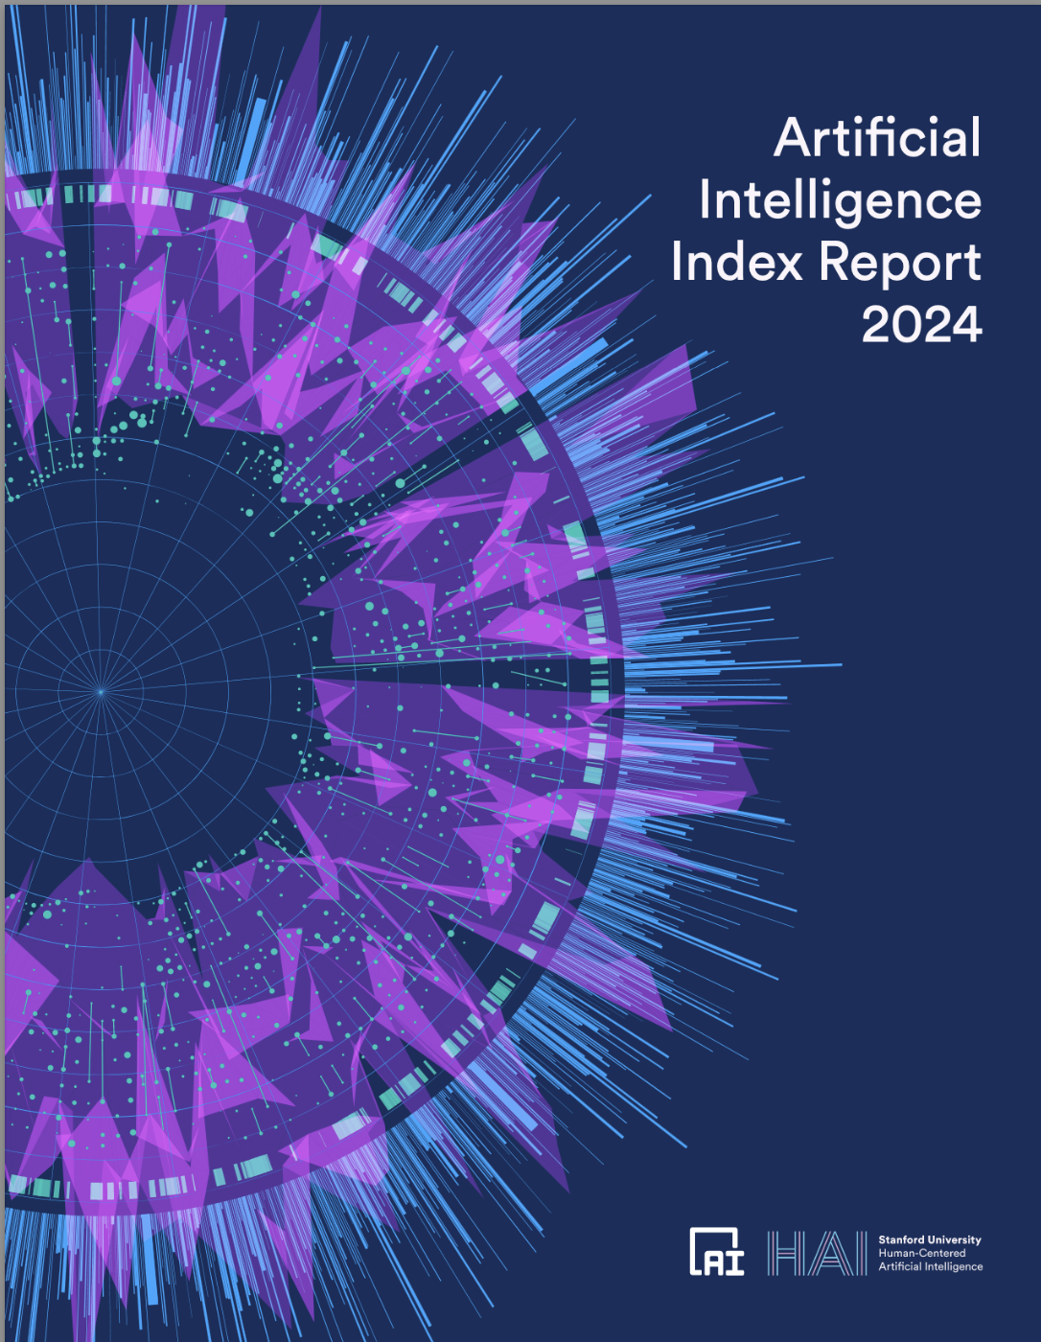
Stanford recently put out a 500+ page report on the state of AI
It only mentions “privacy” three times.
Notes:
https://aiindex.stanford.edu/report/

Slide 9
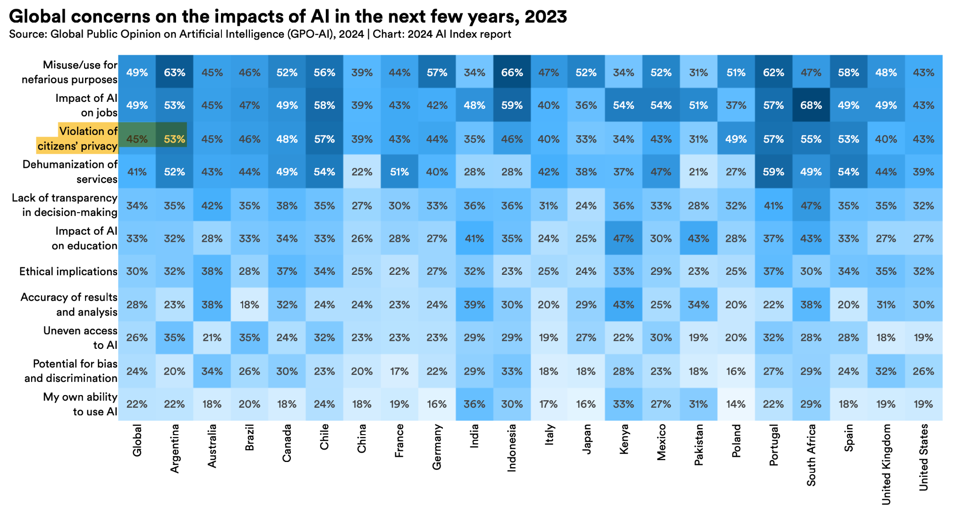
Stanford recently put out a 500+ page report on the state of AI
It only mentions “privacy” three times.
Notes:
https://aiindex.stanford.edu/report/

Slide 10
Remember that concept of
DATA MINIMIZATION?
It doesn’t exist in our new era of AI.
Notes:
https://storage.googleapis.com/deepmind-media/DeepMind.com/Blog/ethics-of-advanced-ai-assistants/the-ethics-of-advanced-ai-assistants-2024-i.pdf

Slide 11
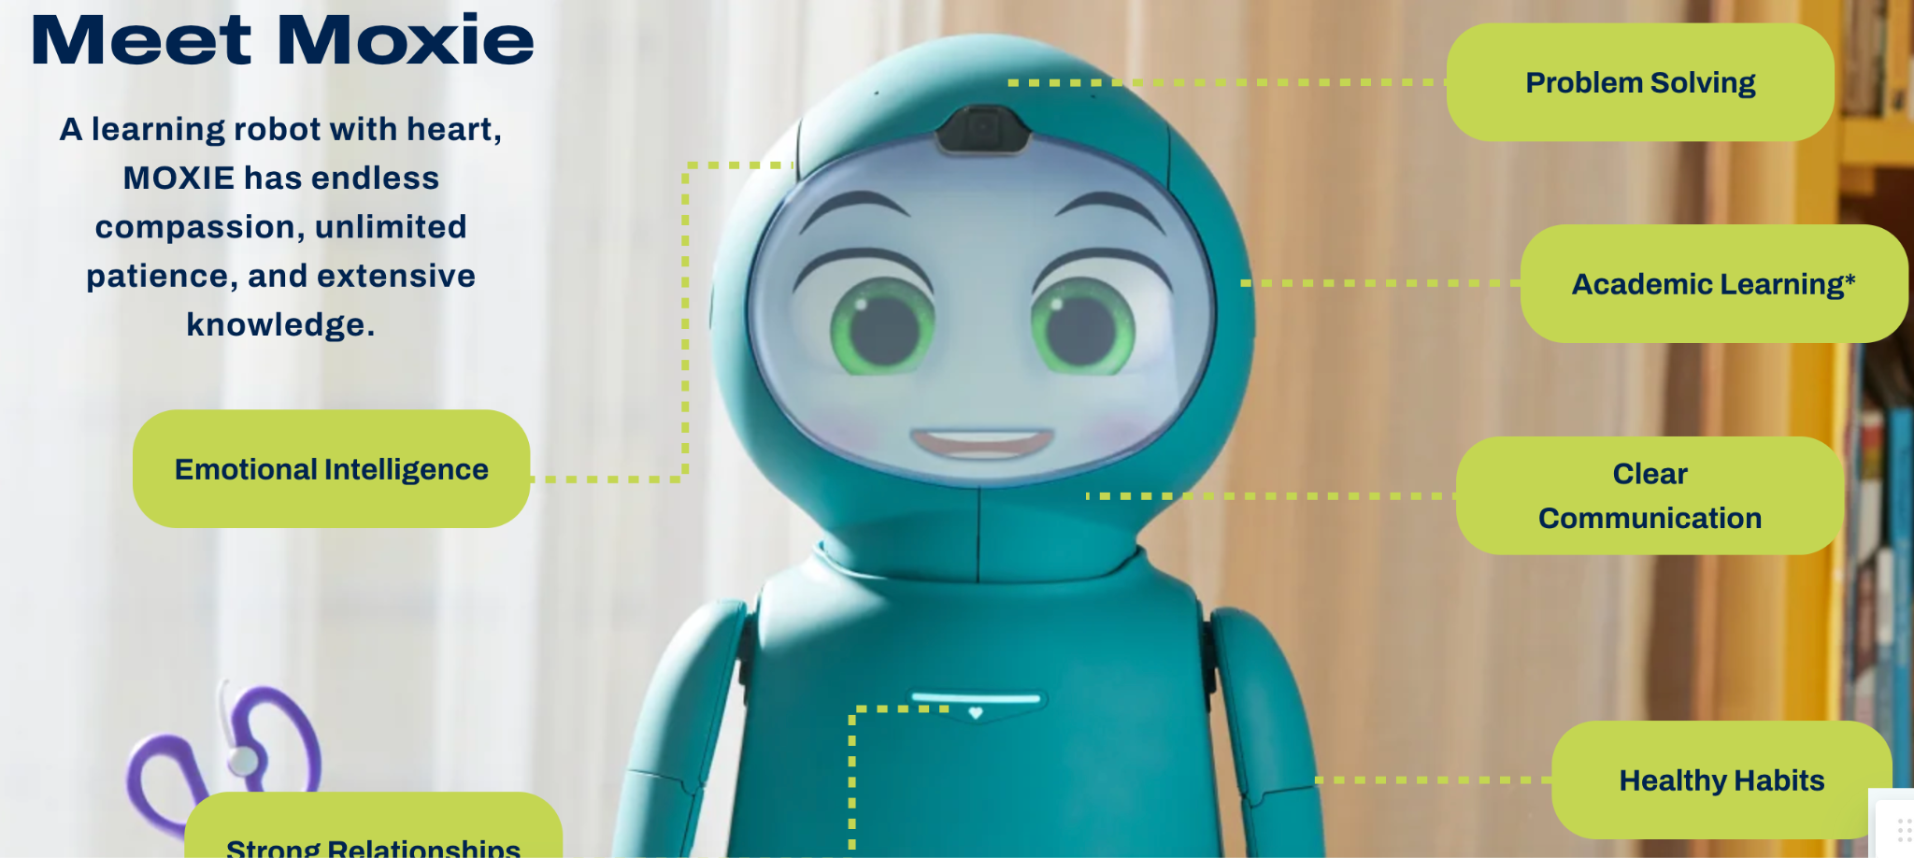
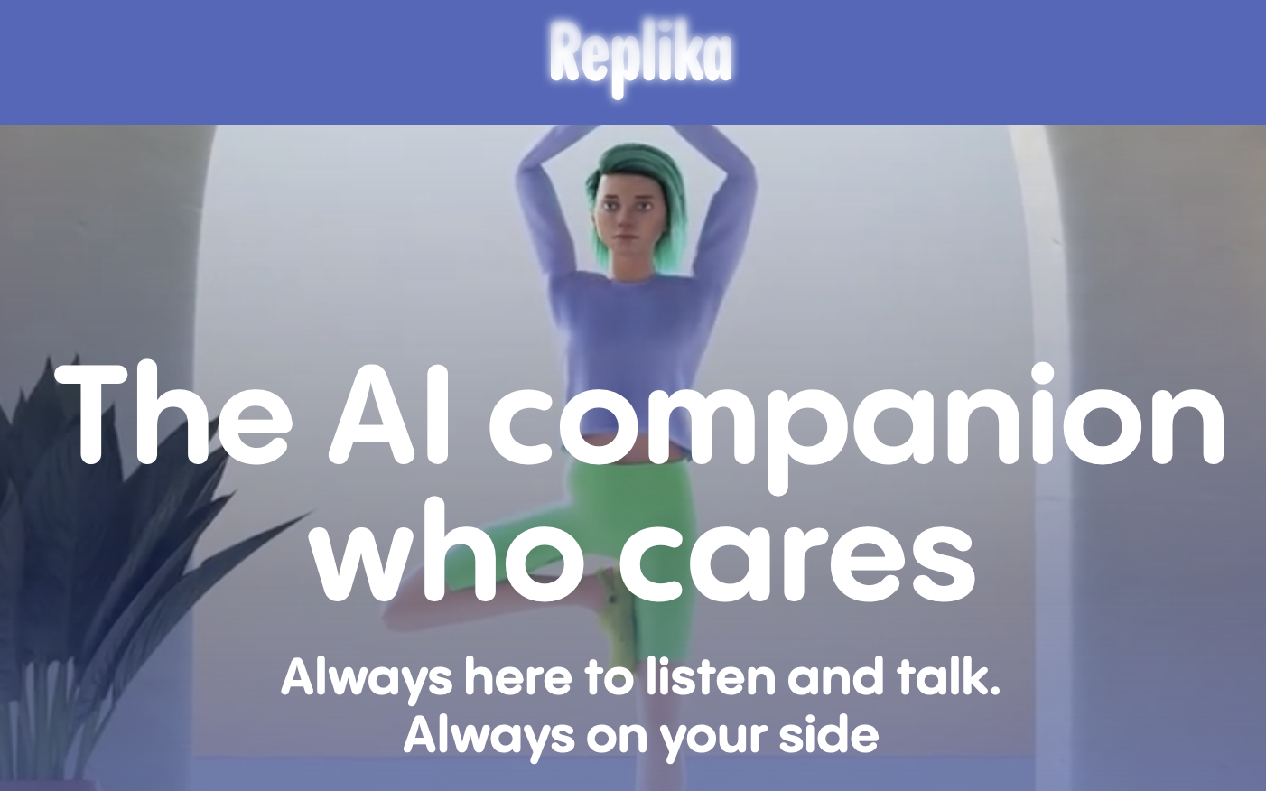
Notes:
https://storage.googleapis.com/deepmind-media/DeepMind.com/Blog/ethics-of-advanced-ai-assistants/the-ethics-of-advanced-ai-assistants-2024-i.pdf

Slide 12
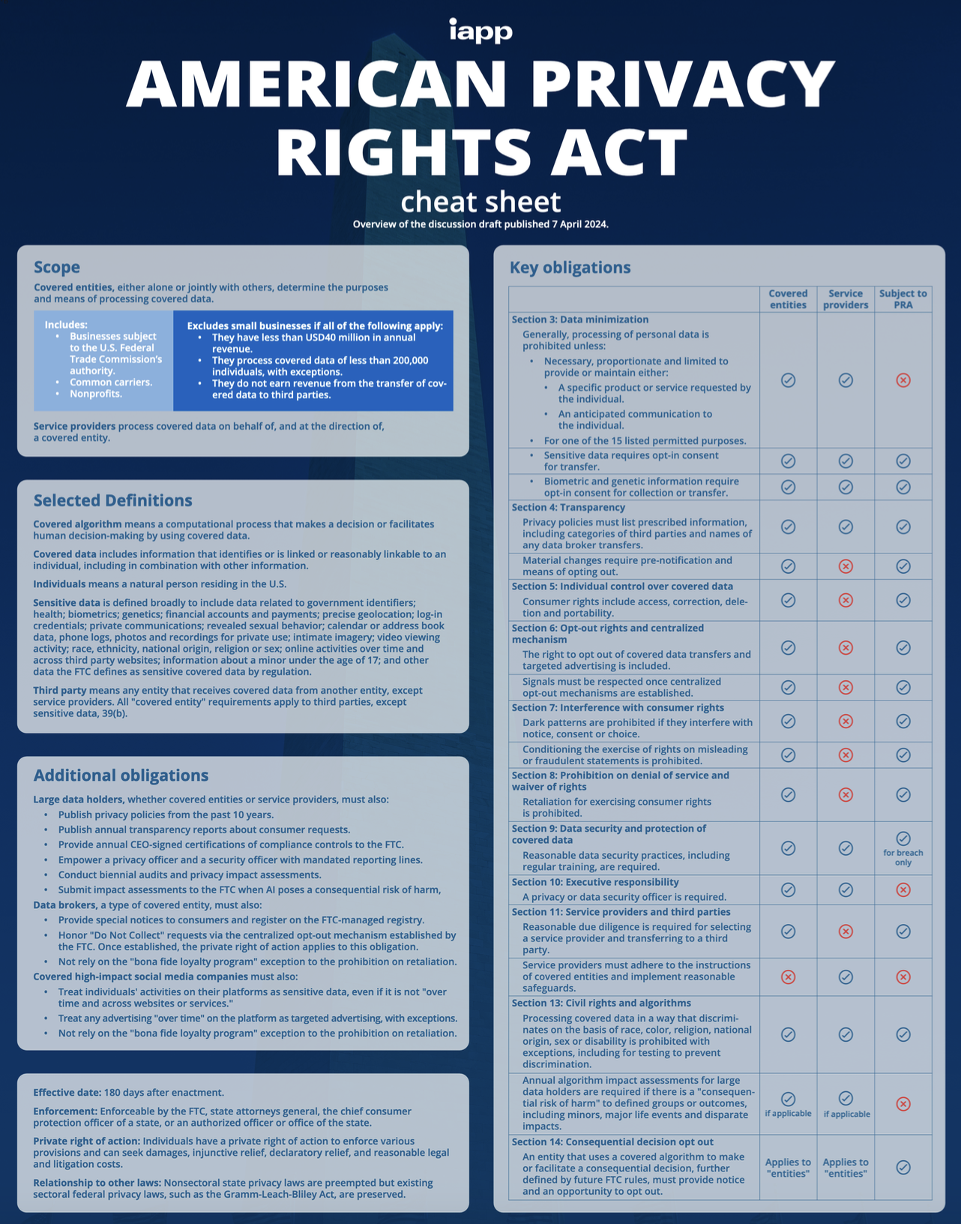
Congress recently proposed a new federal privacy law
Nerdy people refer to it as the APRA
Guess what is the foundation of this newly proposed privacy law?
Yup -- DATA MINIMIZATION
Notes:
https://iapp.org/resources/article/american-privacy-rights-act-cheat-sheet/

Slide 13
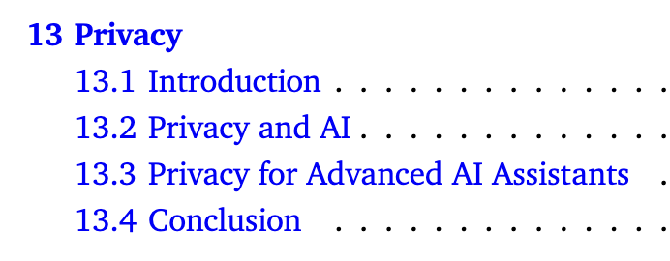
Google Deepmind just published a super wonky paper about AI ethics
It’s all about control…but whose?
Notes:
https://storage.googleapis.com/deepmind-media/DeepMind.com/Blog/ethics-of-advanced-ai-assistants/the-ethics-of-advanced-ai-assistants-2024-i.pdf

Slide 14
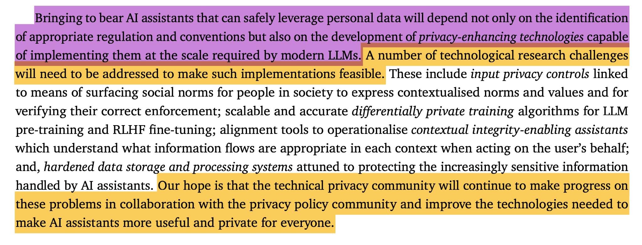
It actually has a six page chapter or privacy!
Still…progress.
Notes:
https://storage.googleapis.com/deepmind-media/DeepMind.com/Blog/ethics-of-advanced-ai-assistants/the-ethics-of-advanced-ai-assistants-2024-i.pdf

Slide 15
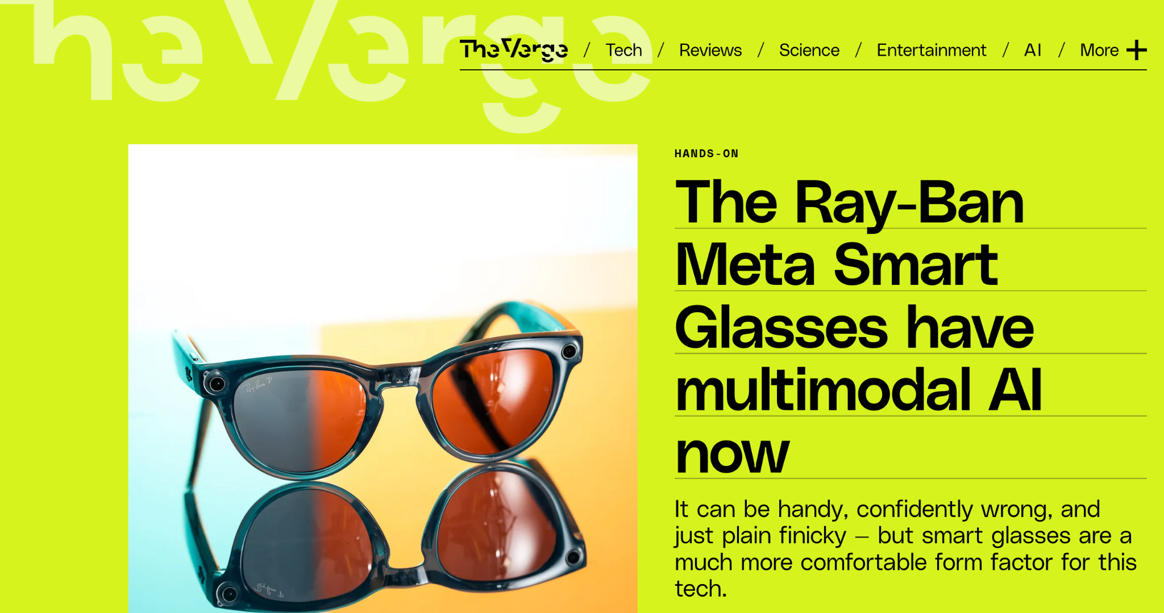
Congress recently proposed a new federal privacy law
Nerdy people refer to it as the APRA
Notes:
https://www.theverge.com/2024/4/23/24138090/ray-ban-meta-smart-glasses-ai-wearables

Slide 16
Notes:
Go watch Terminator and Terminator 2 (you can skip the rest if you want, but you must want 1 so you can watch 2!)

Slide 17
I have way more questions than I do answers
It’s easy to feel rather hopeless about the state of privacy in the age of AI.
That’s where you all come in!!!
More thoughts or questions, email me: jen@mozillafoundation.org

Slide 18
Thank You!
Please ask questions. I love questions.
More thoughts or questions, email me: jen@mozillafoundation.org

