Slide 1
CSSE 132 Data Representation II
Monday, October 14, 2024

Slide 2
Questions
How to represent non-integer numbers?
What is “precision” and “range”?
What does your computer do?

Slide 3
Recap: C data types

Slide 4
Fractional binary numbers
Carnegie Mellon
What is 1011.101₂?

Slide 5
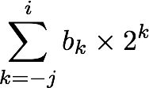
Fractional Binary Numbers
Carnegie Mellon
2^{i}
2^{i-1}
4
2
1
• • •
bi | bi-1 | ••• | b2 | b1 | b0 | b-1 | b-2 | b-3 | ••• | b-j
1/2
1/4
1/8
2^{-j}
• • •
Representation
Bits to right of “binary point” represent fractional powers of 2
Represents rational number:
Notes:
Latex source for equation: \sum_{k=-j}^i b_k \times 2^k

Slide 6
Convert decimal to binary float
Multiply by 2 by shifting left
Try 0.1: 0.0001100110011…
0.1 x 2 = 0.2 – 0
0.2 x 2 = 0.4 – 0
0.4 x 2 = 0.8 – 0
0.8 x 2 = 1.6 – 1
0.6 x 2 = 1.2 – 1
0.2 x 2 = 0.4 – 0
0.4 x 2 = 0.8 – 0
0.8 x 2 = 1.6 – 1
0.6 x 2 = 1.2 – 1

Slide 7
Intuition for Floating Point Representation
How many digits could we use to represent 126,000,000,000?
What about $1.26∗{10}^{11} ?$
12611?

Slide 8
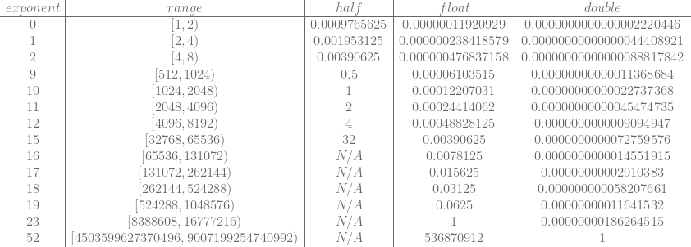
Range vs. Precision
Floats use a variable exponent whose value affects…
Range: min to max values
Precision: “tick” between adjacent values
Source: https://blog.demofox.org/2017/11/21/floating-point-precision/

Slide 9
IEEE 754
Half-precision 16-bit seeeeeffffffffff
1 bit sign
5 bit exponent (unsigned)
10 bit fraction/significand (unsigned)
Formula: (−1)^{sign} × 2^{exp−15} × 1.significand
Simple Examples: 0 01111 0000000000 = (−1)⁰ × 2¹⁵⁻¹⁵ × 1.0000000000₂ = 1 1 00111 0000000000 = (−1)¹ × 2⁷⁻¹⁵ × 1.0000000000₂ = –1 × 2⁻⁸ = –2⁻⁸

Slide 10
IEEE 754 (cont.)
1 bit sign
8 bit exponent (unsigned)
23 bit (24 with leading 1) fraction/significand (unsigned)
Special cases:
Zeros: sign = 1 or 0, exp = all 0, significand = all 0
Infinity: sign = 1 or 0, exp = all 1, significand = all 0
NaN: sign = 1 or 0, exp = all 1, significand = anything not all 0
float

Slide 11
What can go wrong?
Remember that both range and precision, while flexible, are limited.
In what ways can our abstract understanding of numbers be fooled by the reality of the datatype?

