Slide 1
CSSE 132 The Stack
Thursday, January 9, 2025

Slide 2
Outline
Motivation
Stack overview
Practice

Slide 3
Reminder: Registers
In Armv8-A (aarch64, arm64) there are 31 general-purpose 64-bit registers.
Each register can be used as a 64-bit X register (X0..X30), or as a 32-bit W register (W0..W30). [Case-insensitive: x0 same as X0]
Recommended to use registers 0–15 in your code
When a W register is written, the top 32 bits of the 64-bit register are zeroed.
ADD w0, w1, w2 @ 32-bit addition on registers 0 and 1
ADD x0, x1, x2 @ 64-bit addition on the same registers!

Slide 4
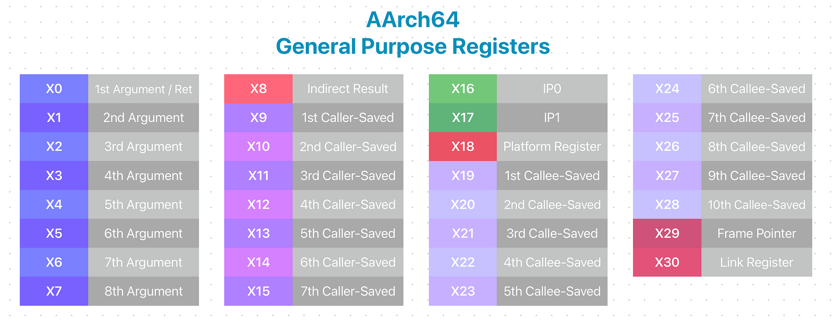
ARM64 Registers
lr
Source
Other important registers:
sp stack pointer
pc program counter

Slide 5
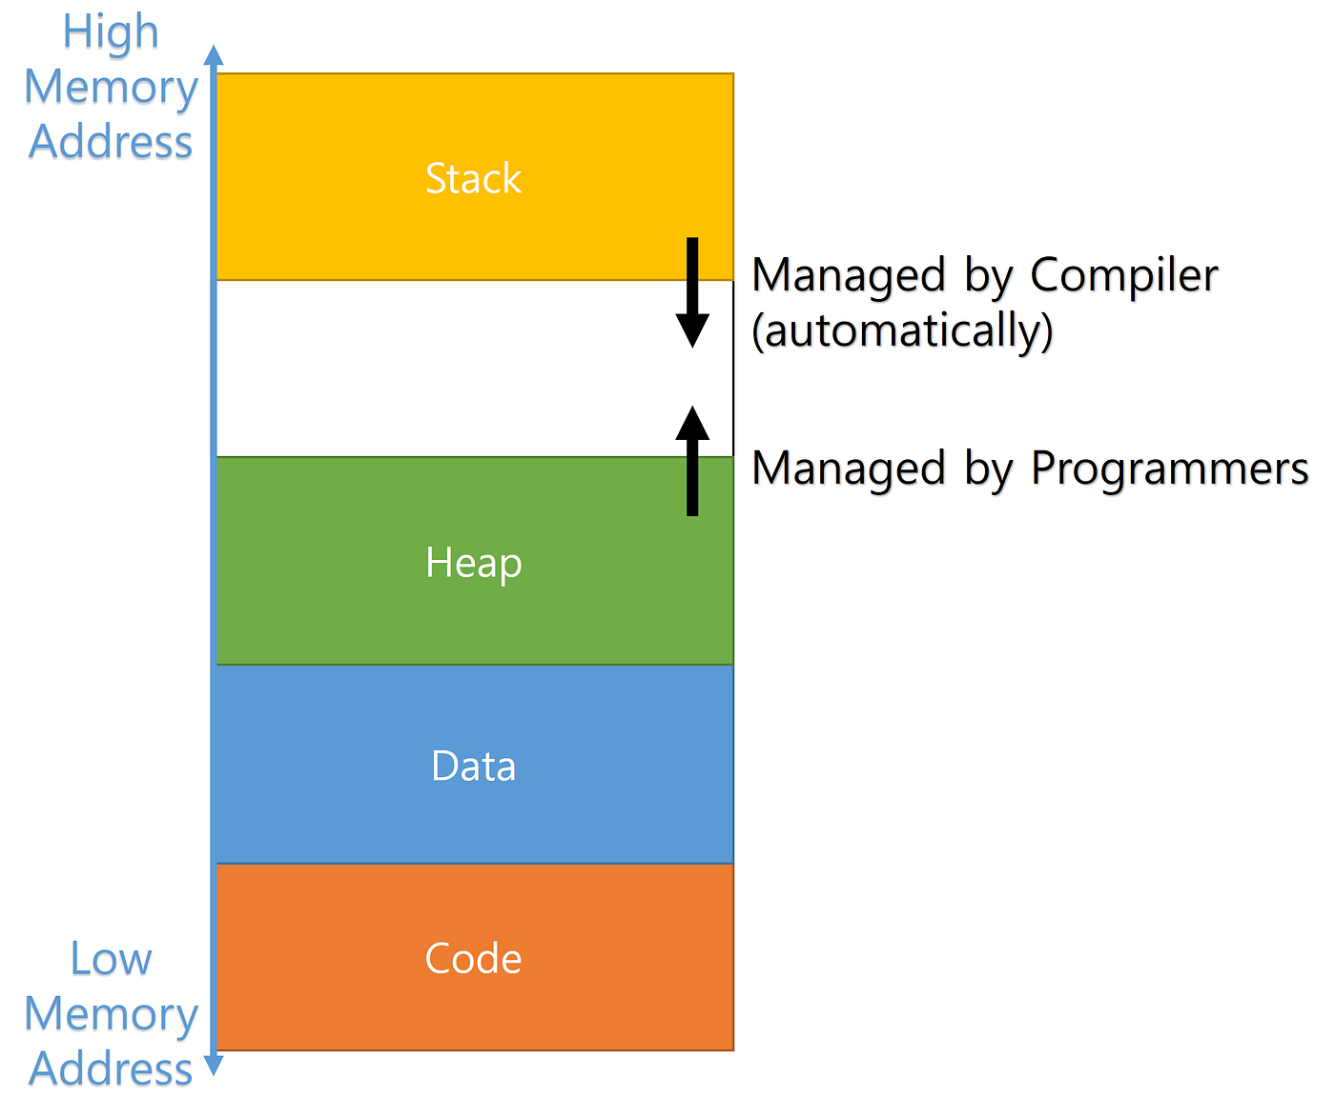
A Process’s View of (Virtual) Memory
Managed “automatically”
(by compiler)
Managed dynamically
(at runtime)
Initialized when process starts
Not executable
Initialized when process starts
Executable
Source

Slide 6
The Stack
Handle function calls, like when main calls my_func
Store local variables/automatic variables
main
↳ my_func
Stack frame of
main
sp_{main}
Stack frame of
my_func
sp_{my_func}

Slide 7
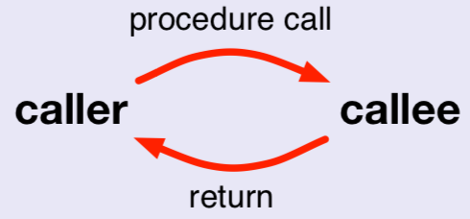
How to handle a function call
Caller vs. callee
caller the code that calls the procedure
callee the code that implements the procedure
main
↳ my_func
main
my_func

Slide 8
What the caller does
Set up input arguments in registers 0, 1, 2, …
bl proc: Branch link to procedure
return address goes in lr, a.k.a. x30
On return, read return value from register 0

Slide 9
What the callee does
(Possibly) Back up lr register to be modified
Assign values of input arguments from registers 0, 1, 2, …
Run function body
Fill up register 0 for return
(If needed) Restore register lr
Go back to next instruction in call by branching to lr

