Slide 1
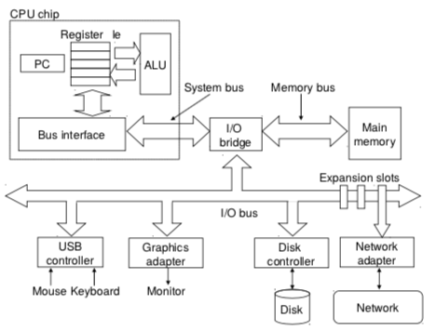
CSSE 132
Memory Addressing
Monday, September 9, 2024

Slide 2
Questions
How to manage data in memory?
Notes:
Do a quick recap on the top-down view.

Slide 3
Where is memory?

Slide 4


Locating data
Each byte has an “address”.
We name the bytes by counting.

Slide 5
Locating data (cont.)
How big can memory be?
  How big is your computer’s address space? (Hint: you have a 64-bit system)

Slide 6
Locating data (cont.)
For larger objects (more than a byte), we need to specify the order of storing bytes in memory.
  Little-Endian: Low-order byte (Least Significant Byte) is stored at a lower address.
  Big-Endian: High-order byte (Most Significant Byte) is stored at a lower address.

Slide 7
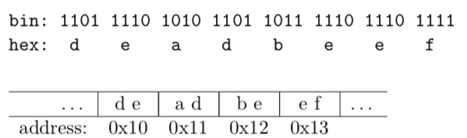

Locating data (cont.)
Example:
Big Endian
Good for comparison
Little Endian
Good for arithmetic operation

