Slide 1
CSSE 132 Pointers and Arrays
Wednesday, December 15, 2021

Slide 2
Questions
What is a pointer?
How to carefully use pointers?
pointer operation
pointer arithmetic
How do data arrays work in C?
How to use pointers to access array elements?
How are “strings” handled in C?

Slide 3
Variables in memory
When you declare int x:
Memory is allocated for x at a certain address
Machine handles/remembers address of x
(actually, handled at compile time)
0x0000 0008 | x

Slide 4
Pointer operation
Type int* xp means “xp is the address of an int”
int* xp;
Getting the Address: &x means “address of data in x” & is the address operator and asks “where is this thing?”
int x = 3;
xp = &x;
Dereference: retrieving/setting data at an address:
*xp means “the data at memory address xp”
int y = *xp;
Can also be used to set that data
*xp = 5;

Slide 5
Pointer illustration
Pointer is the address (key) to a container (cabinet)
int* ptr;
int var = 50;
ptr = &var;
//*ptr == 50

Slide 6
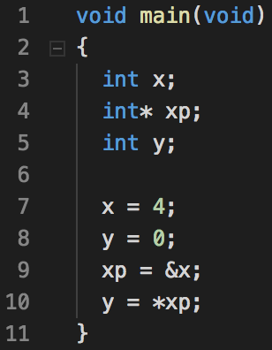
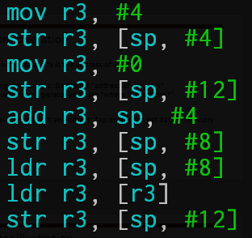
Example: pointers1.c
[ ] means to sum the things inside and dereference the resulting address (like *addr)

Slide 7
Pointer arithmetic
Assume a pointer p to type <type>, and p has value X (an address)
Then p + n (n is an integer) is a pointer, and has value (address)
X + n*size(type)
This means, if there are enough items of type <type> in memory starting at p, then
p points to the 0th item of type <type>
(p + n) points to the n^{th} item of type <type>

Slide 8
Pointer arithmetic (cont.)
0x0000 0008 | x
0x0000 000c | xp
0x0000 0010 | y
int x;
int* xp;
int y;
x = 4;
xp = &x;
y = 0;
xp = xp + 2 // it adds two of size(type) to xp
*xp = 7;
What is y? (assume using GCC)

Slide 9
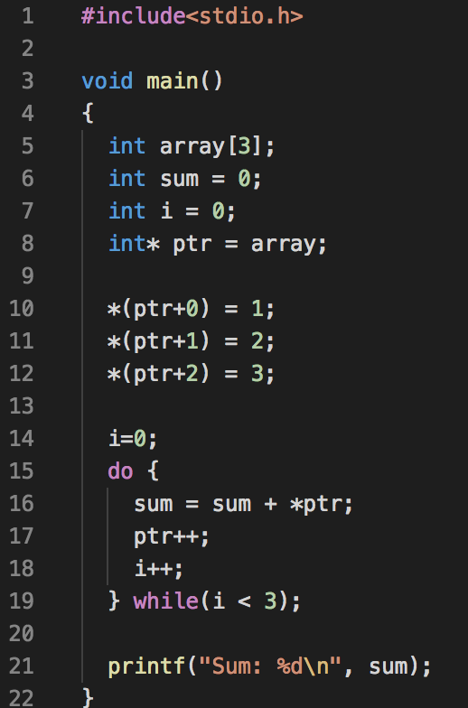
Arrays are Pointers
An array is a continuous chunk of memory
array[1] is *(array + 1)

Slide 10
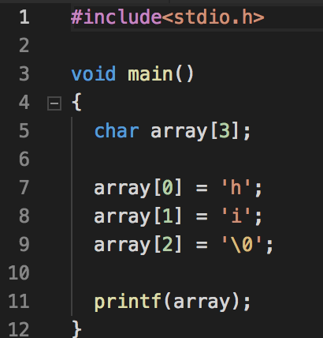
Strings
Arrays of characters (each 1 byte)
Length is determined by the location of a null char ‘\0’

