Slide 1
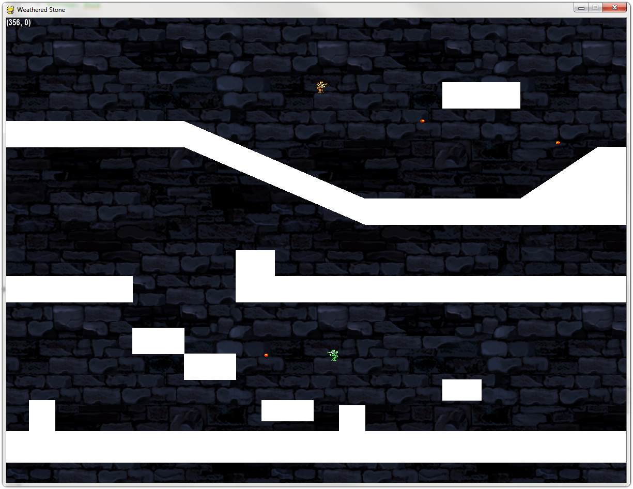
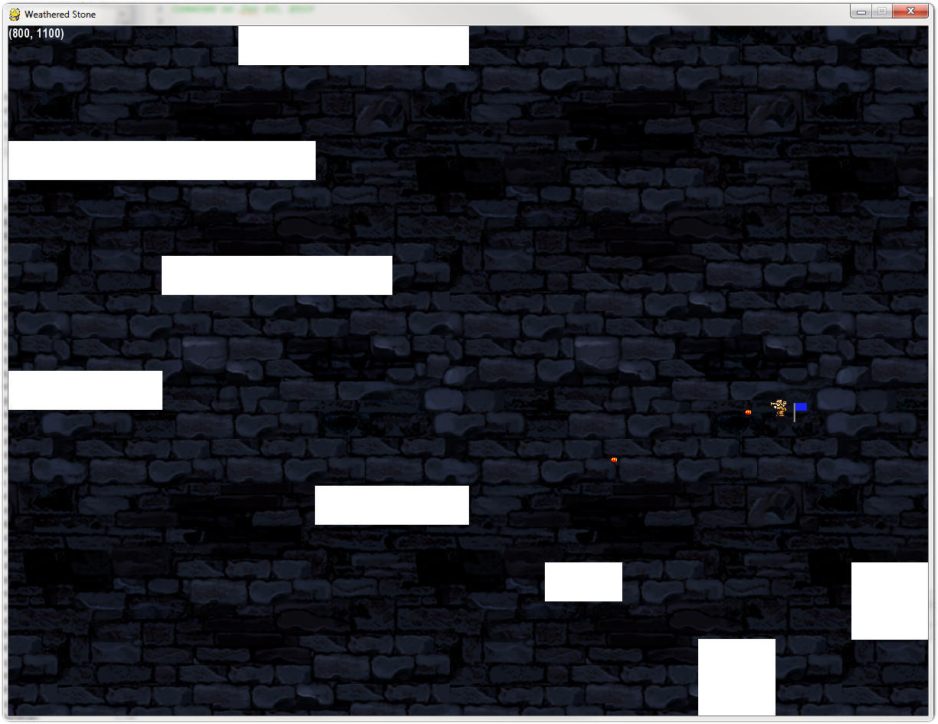
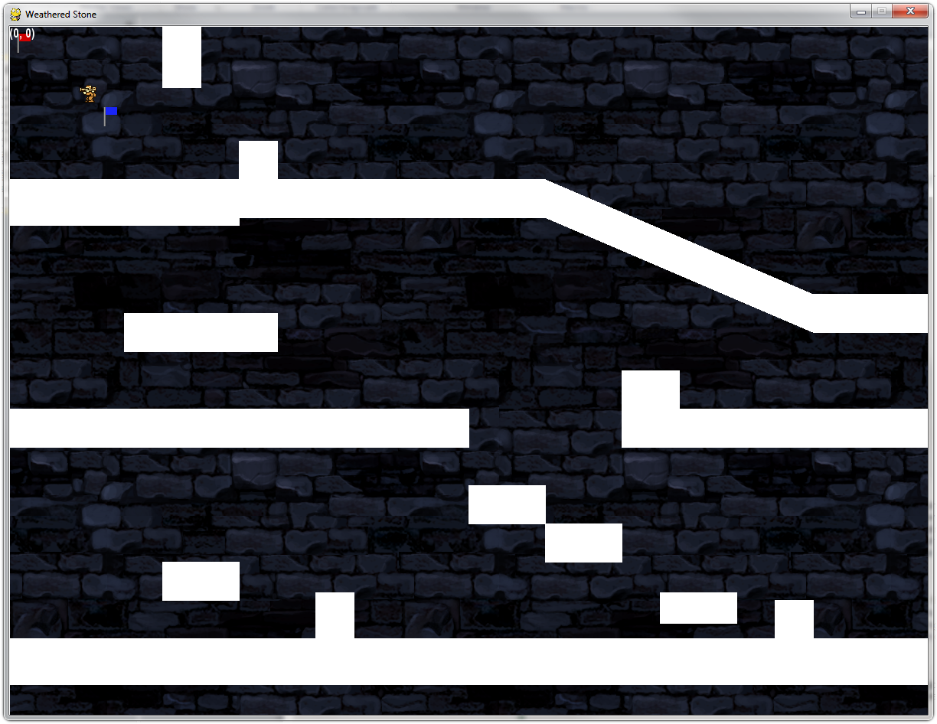
Operation Catapult
Team 31
Rodney Folz
AJ Piergiovanni
A game demonstration of the Genesis engine
June 15 – June 18:
Learn Python and PyGame
June 21:
Pick project and partners
Code sprite class
Code basic camera demo
Code world view
June 22:
Write Vector class
Test Vector interactions
June 23:
Consolidate existing code into an engine
Test the engine
Code terrain and slope
Begin writing network code
June 24:
Designed sprites and background images
Write network code
Begin designing the game
June 25:
Code player characters
June 28:
Field trip to Beckman-Coulter
June 29:
Code shooting, flag capture
Re-write network code
June 30 – July 2:
Level design
Debug and optimize engine
A powerful Python game engine, featuring:
Custom sprites
Vector movement and collisions
Gravity physics
Scrollable camera view
Network gaming library
Parallax background effects
The Fine Print
Introduction
Python is a programming language emphasizing simplicity and ease of use. PyGame is a set of Python modules that allows Python to access graphics and audio libraries. However, PyGame lacks support for many functions necessary for game development, including those mentioned above. To fix that, we designed and wrote a game engine, Genesis, that handles those low-level aspects of game programming, allowing programmers to focus their energies on the overall feel of their game.
How it works
The various features of Genesis are contained in their own modules. For instance, there is a Geometry module that contains vector code, and a Viewport module that contains the camera code. This modularity allows Genesis to handle each different part of making a game separately from the others. Programmers are able to use these modules in their own code, which lets them leverage the power of Genesis however they see necessary.
Results
The Genesis engine is production-ready, and can be used to make high-quality games quickly and with less effort than making games with only PyGame. Refer to Weathered Stone for a production demonstration.
Gold and green face off over a local area network
The gold player captures the blue team’s flag…
…and returns it to his base to score!

